Slide 1
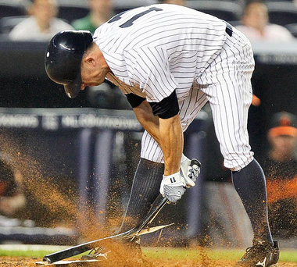
Reducing Struggles of Frustration in Major League Baseball Through Epidemics
Daniel Hrusovsky
John Carroll university
April 9, 2025

Slide 2
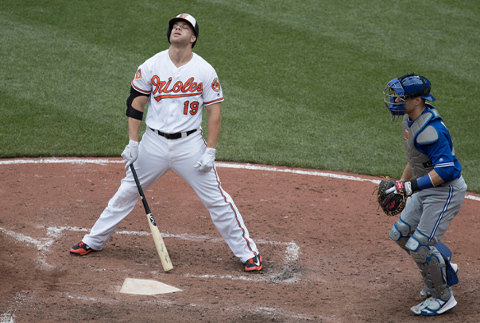
Struggles in Sports
Professional athletes have stretches of time in which they perform poorly in their respective sport.
These struggles affect individuals both mentally and physically, leading to worse performance and a negative mindset.
Baseball is one of the easiest sports to “struggle” in, with athletes falling into slumps due to the difficult nature of the sport.

Slide 3
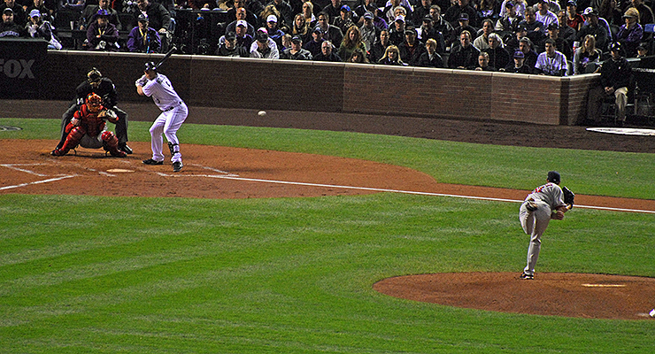
Spread of Frustration
This frustration can come from both pitchers and hitters in baseball, as both share the common goal of winning upon interaction.
As the pitcher or hitter wins repeatedly, the other begins to struggle.
Once struggling, the athlete can either continue to perform poorly or revert to their “dominance”.

Slide 4
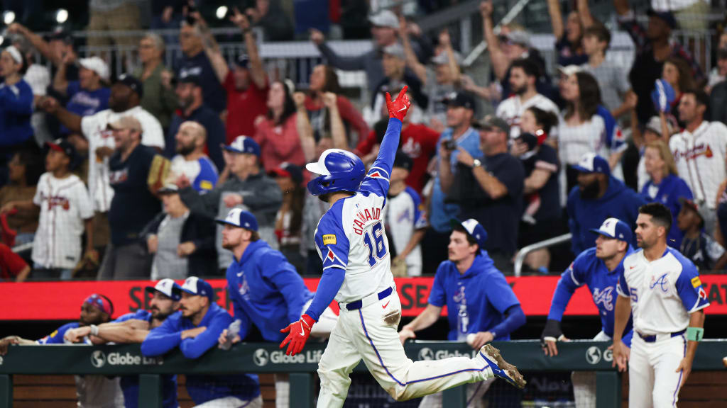
The Solution
The goal is to minimize the number of frustrated, struggling batters and maximize the number of “dominating” batters.
Minimizing frustrated batters will optimize run scoring, allowing fans to be more excited and generate more revenue for Major League Baseball.

Slide 5
Development of Model
Based on two traditional SI models involving the population of hitters (B_{D}, B_{S}) and population of pitchers (P_{D}, P_{S}), each interacting with each other.
B_{D} represents the batters who are deemed “dominant” or not struggling.
B_{S} represents the batters who are struggling and frustrated.
P_{D} represents the pitchers who are “dominant”.
P_{S} represents the pitchers who are struggling.
Since there are only 13 pitchers and hitters on a roster, there are a total of 390 players in our populations.
An individual cannot “fully recover”, as they are always struggling or not struggling.

Slide 6
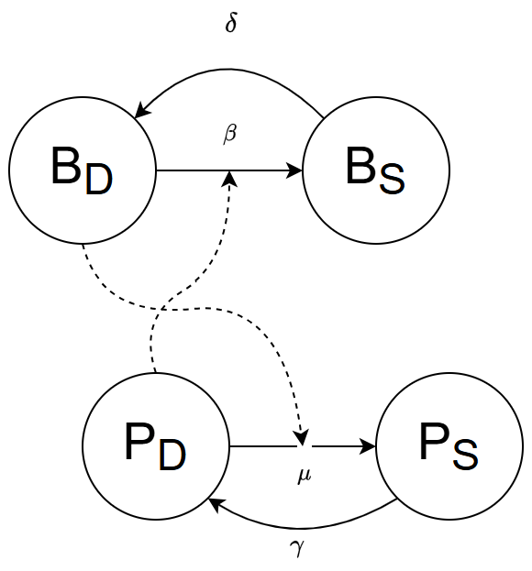
Flow Diagram

Slide 7

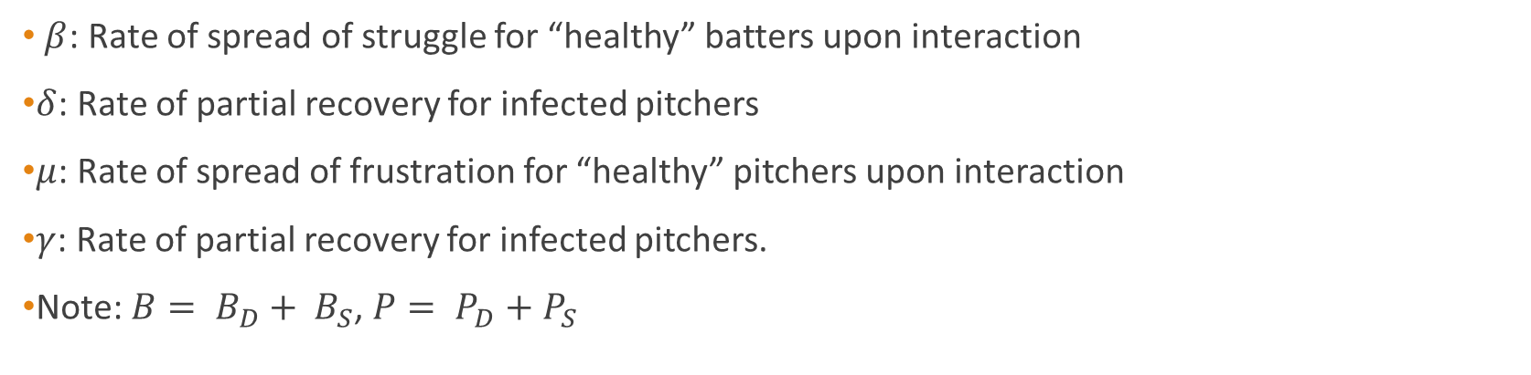
Model
$$\left\{\begin{aligned}\acute{B_{D}}=−βB_{D}P_{D}+δB_{S} \\ \acute{B_{S}}=βB_{D}P_{D}−δB_{S} \\ \acute{P_{D}}=−μB_{D}P_{D}+ γP_{S} \\ \acute{P_{S}}=μB_{D}P_{D}− γP_{S}\end{aligned}\right.$$
$β$: Rate of spread of struggle for “healthy” batters upon interaction
$δ$: Rate of partial recovery for infected pitchers
$μ$: Rate of spread of frustration for “healthy” pitchers upon interaction
$γ$: Rate of partial recovery for infected pitchers.
Note: $B= B_{D}+ B_{S}$, $P= P_{D}+P_{S}$

Slide 8
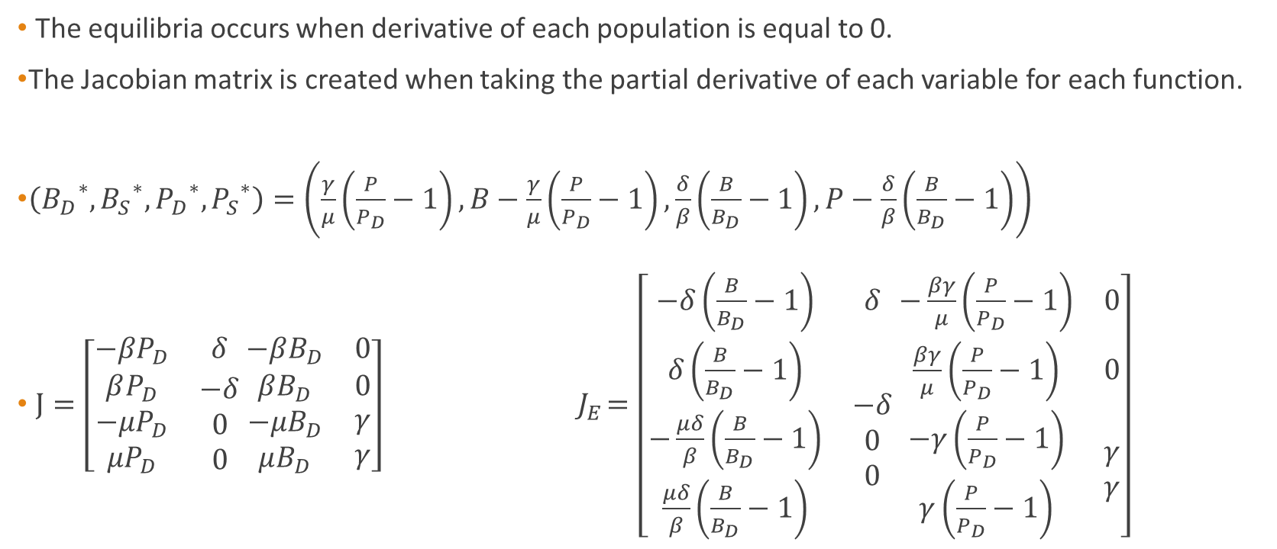
Equilibria and Jacobian
The equilibria occurs when derivative of each population is equal to 0.
The Jacobian matrix is created when taking the partial derivative of each variable for each function.
$\left({B_{D}}^{∗}, {B_{S}}^{∗}, {P_{D}}^{∗}, {P_{S}}^{∗}\right)=\left(\frac{γ}{μ}\left(\frac{P}{P_{D}}−1\right), B−\frac{γ}{μ}\left(\frac{P}{P_{D}}−1\right), \frac{δ}{β}\left(\frac{B}{B_{D}}−1\right), P−\frac{δ}{β}\left(\frac{B}{B_{D}}−1\right)\right)$
$J=\left[\begin{matrix}−βP_{D} & δ \\ \begin{aligned}βP_{D} \\ −μP_{D} \\ μP_{D}\end{aligned} & \begin{aligned}−δ \\ 0 \\ 0\end{aligned}\end{matrix} \begin{matrix}−βB_{D} & 0 \\ βB_{D} & 0 \\ \begin{aligned}−μB_{D} \\ μB_{D}\end{aligned} & \begin{aligned}γ \\ γ\end{aligned}\end{matrix}\right] { J}_{E}=\left[\begin{matrix}−δ\left(\frac{B}{B_{D}}−1\right) & δ \\ \begin{aligned}δ\left(\frac{B}{B_{D}}−1\right) \\ −\frac{μδ}{β}\left(\frac{B}{B_{D}}−1\right) \\ \frac{μδ}{β}\left(\frac{B}{B_{D}}−1\right)\end{aligned} & \begin{aligned}−δ \\ 0 \\ 0\end{aligned}\end{matrix} \begin{matrix}−\frac{βγ}{μ}\left(\frac{P}{P_{D}}−1\right) & 0 \\ \frac{βγ}{μ}\left(\frac{P}{P_{D}}−1\right) & 0 \\ \begin{aligned}−γ\left(\frac{P}{P_{D}}−1\right) \\ γ\left(\frac{P}{P_{D}}−1\right)\end{aligned} & \begin{aligned}γ \\ γ\end{aligned}\end{matrix}\right]$

Slide 9

Stability Analysis
Using Next-Generation Matrix approaches, we can calculate the stability of the model.
$λ=−a ± \sqrt{a^{2}−b}, a=−δ\left(\frac{B}{B_{D}}\right)−γ\left(\frac{P}{P_{D}}\right), b=4δγ(\frac{P}{P_{D}}+\frac{B}{B_{D}}−1)$
$\sqrt{a^{2}−b}<\sqrt{a^{2}}=a ⇒−a ± \sqrt{a^{2}−b}<0$
$λ<0⇒E$ always stable

Slide 10
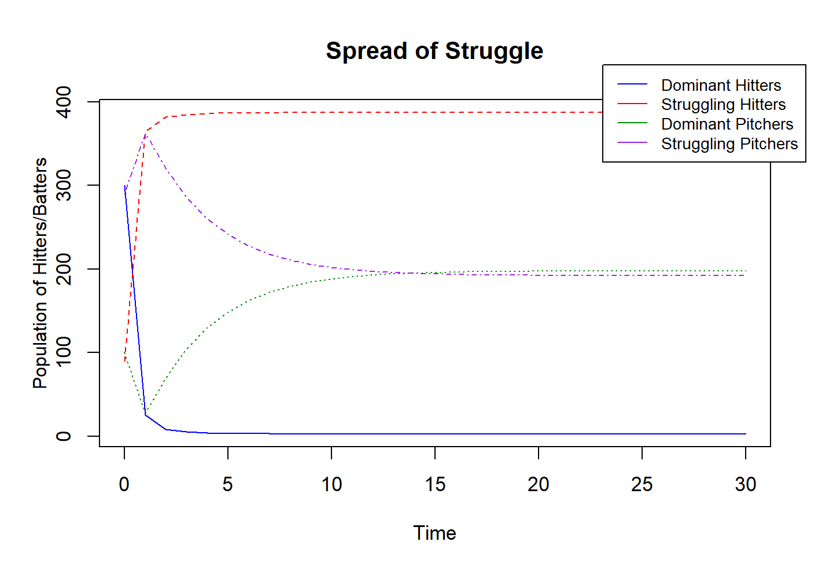
“Hitter Dominant” Simulation
$$β=0.226, δ=0.312, μ=0.117, γ=0.3257$$

Slide 11
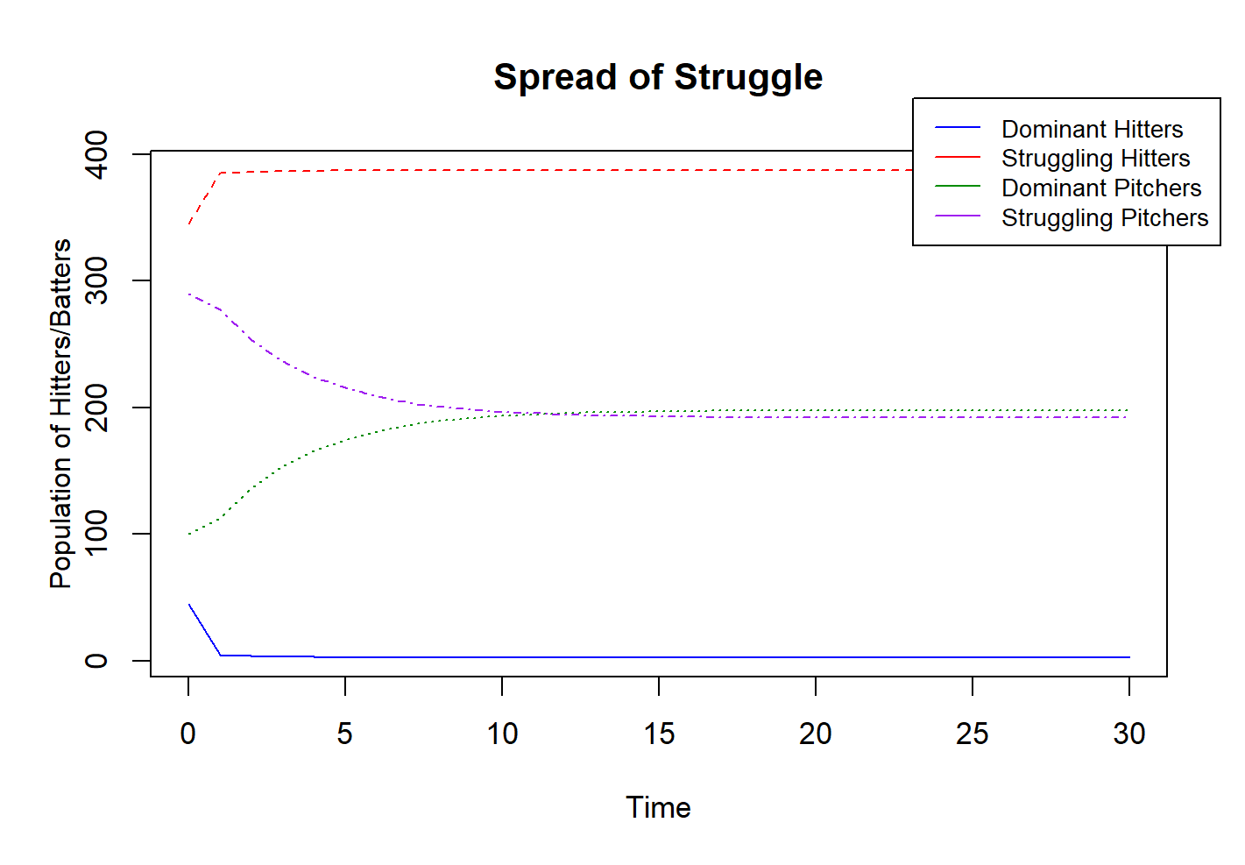
“Struggling Hitter” Simulation
$$β=0.226, δ=0.312, μ=0.117, γ=0.3257$$

Slide 12
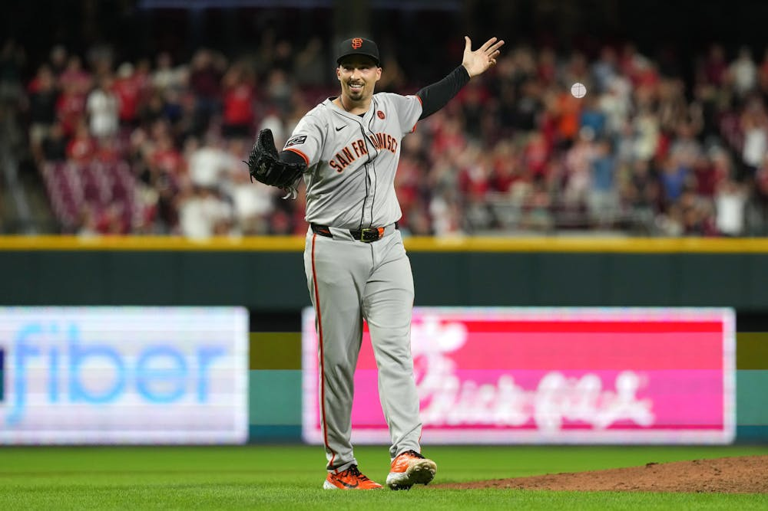
Observations
It does not appear possible for hitters to prevent struggling against pitchers.
Pitchers always sink towards the middle, with slightly more struggling batters.

